Slide 1
Domestic Violence 101 and it’s Impact on Young Children
Our mission is dedicated to helping individuals achieve lives free of domestic violence by providing care, advocacy, support, and education. Our goal is to address the immediate and ongoing needs of adult and child victims of domestic violence through the provision of comprehensive services.
Tyshaunda Wiley
Prevention Coordinator
Presented 12/14/2016
to the Early Childhood Collaborative of Southington

Slide 2
Domestic violence is primarily a crime against women; however, men can be abused as well. Women account for 85% of the victims of intimate partner violence and men account for approximately 15%.
1 in 4 women will be victims of severe violence by an intimate partner in their lifetimes.
1 in 7 men will be victims of severe violence by an intimate partner in their lifetimes.

Slide 3
Abuse can occur to anyone regardless of age, gender, race, religion, socio-economic status, or sexual orientation.
Females ages 18 to 24 and 25 to 34 generally experienced the highest rates of intimate partner violence
15% of teens who have been in a relationship, report having been hit, slapped or pushed by their boyfriend or girlfriend
Lack of parental/caregiver awareness
Only 33% of teens who were in an abusive relationship ever told anyone about the abuse.
81% of parents believe teen dating violence is not an issue or admit they don’t know if it is an issue

Slide 4
In 2008, lesbians, gays, bisexuals, transgender, queer people and intersex (LGBTQI) reported 3,419 incidents of domestic violence to local anti-violence programs. Nine of these incidents resulted in murder.

Slide 5
There are other ways of responding when you are angry. It’s okay to be angry , but people have a choice whether to be abusive.
The actions of abusers are very deliberate. They use violence to gain and maintain power and control.
65% of women physically assaulted by an intimate partner report having been assaulted multiple times by the same partner.
75% of intimate partner femicides reviewed in a 1999 study were preceded by one or more incidents of stalking within a year of the crime.

Slide 6
Victims of domestic violence are often prevented from getting or keeping jobs by their abusers, and many victims who leave their abusers face poverty, unemployment, and homelessness as a result of leaving. Barriers to ending an abusive relationship also include:
Fear
Shame
Lack of Safe Options
Trauma
Lack of Social Support
Hopes, Good Times
History of Inappropriate Reactions, Responses
On average, it takes a victim seven times to leave before staying away for good. Exiting the relationship is most unsafe time for a victim (“Break-up Violence”). As the abuser senses that they’re losing power, they will often act in dangerous ways to regain control over their victim.

Slide 7
Prudence Crandall Center
Since 1973, Prudence Crandall Center, Inc. has addressed the needs of victims of domestic violence. The initial focus of the center was to identify the health, employment, and social service needs of area women and empower them to participate in all aspects of community life.
We are the oldest domestic violence program in Connecticut and the second oldest in the country.
The combination of services we provide is the first of its kind in Connecticut and one of the few in the nation.
Our service area includes the Connecticut towns:
Berlin Bristol
Burlington Kensington
Plainville Plymouth
New Britain Southington
Terryville

Slide 8
Services
24-hour crisis hotline
Emergency shelter in a safe, confidential and supportive environment
Support groups for adults and children
Short-term individual counseling for adults and children
Advocacy and support during court proceedings
Advocacy and support as a follow-up to New Britain police calls
Transitional Housing Program
Permanent Supportive Housing Program
Information & referrals for services
Community education and training including certification courses, and domestic violence, teen dating violence, and healthy relationships curriculum
Volunteer, internship, and practicum opportunities
Services are
FREE and CONFIDENTIAL and available in
English Spanish and Polish

Slide 9
Crisis intervention
Our hotline is available 24-hours a day to assist callers.
Callers have immediate access to a Certified Domestic Violence Counselor.
Provides Crisis Intervention, Counseling, Shelter Services, Information and Referrals.
860-225-6357 OR 1-888-774-2900

Slide 10
Counseling Services
This program is available to women and men who have been, or currently are victims of domestic violence, dating violence and/or elder abuse
Services
Short-term Individual Counseling
Support Groups in New Britain and Bristol
Information
Referrals
Advocacy

Slide 11
Rose Hill Campus
Prudence Crandall Center's Rose Hill Campus offers survivors several housing options
The Rose Hill Supportive Housing Program serves homeless women and women with children with a history of domestic violence. This program includes specialized services to help women and their children regain their independence.
-8 units of transitional housing
-10 units of permanent supportive housing
-10 Scattered Site Apartments in New Britain

Slide 12
Prevention Education and Outreach
Designed to reduce domestic violence in our communities by providing prevention education programs.
Available for schools, Churches, and Community Groups on a variety of topics related to domestic violence.
Training Programs are also available for Childcare Providers, Police, Medical Personnel and other Professionals.

Slide 13
Child Advocacy Program
This program provides services to children whose lives are affected by domestic violence.
Services:
Educational And Recreational activities
Individual counseling
Support Groups
Advocacy and Referrals.
These services are available to sheltered and non-sheltered children, youth and teens.

Slide 14
Shelter Services
The center provides a 20-bed emergency shelter for men, women, and children who are forced to flee their homes because of domestic violence.
Residents can stay in shelter for a period of up to 60 days (stays can be extended).
Access to services including:
Individual Counseling
Support Groups
Advocacy
Information and Referrals to Legal Services
Housing Services
Mental Health/Substance Abuse Services

Slide 15
Family Violence Victim Advocate (FVVA) Program
The FVVA’s work in New Britain and Bristol Courts.
The FVVA Program assists victims of domestic violence through the civil and criminal court process by providing information and support.
The FVVA meets with the victims to determine the extent of violence and to provide counseling, information and referrals.

Slide 16
What is Domestic Violence?
Domestic violence is a pattern of abusive and coercive behaviors that abusers use to control their intimate partners.
It is an intentional behavior. It’s purpose is to exert control and power over another person.

Slide 17
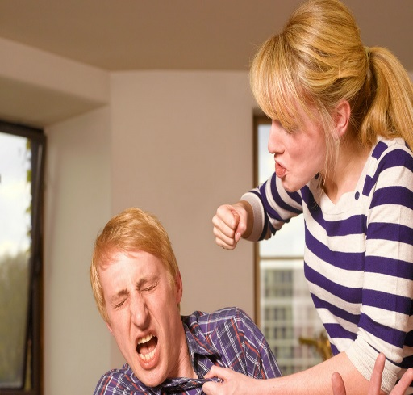
What is Domestic Violence?
Domestic violence is fluid. It is a pattern of behaviors, not a single event or an isolated incident. Events include both positive and negative behaviors.
Domestic violence will escalate over time. Abuse can happen at a very slow pace. Little by little, a relationship goes from healthy-unhealthy-abusive before it is recognized by the victim.

Slide 18
What is Domestic Violence?
Domestic violence is intentional.
The abuser is actively trying to change the victim’s behavior. When the victim doesn’t do what the abuser wants, the abuser will punish him or her. The victim will change his or her behavior to avoid punishment and accommodate the abuser.

Slide 19
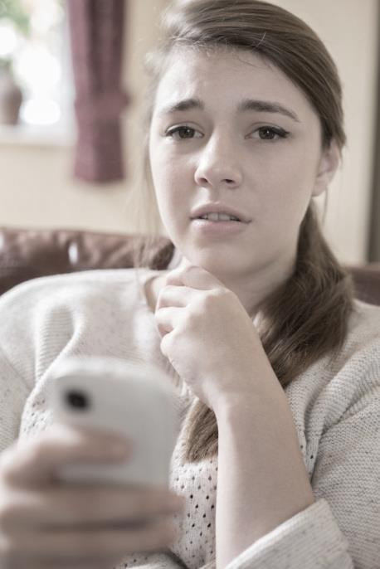
Abusive Tactics
Physical Emotional Sexual Financial Technological

Slide 20
Physical abuse:
Hitting, pushing
Shoving, slapping, punching
Holding or restraining
Strangling, choking
Inflicting bruises
Welts and lacerations
Dragging, pulling by hair
Restraining
Marking, branding

Slide 21
Emotional abuse:
Threatening, intimidation
Humiliation
Extreme jealousy/possessiveness
Threatening acts of violence
Constant criticizing
Insulting and belittling
Ignoring or dismissing the victim
Denying, minimizing and blaming
Invading privacy
Notes:
Emotional abuse is behavior intended to cause psychological or emotional pain. You

Slide 22
Sexual abuse:
Coercing victim to have sex
Making victim watch pornographic movies
Sexually transmitted diseases
Demanding sexual photos
Using date rape drugs
Sabotaging birth control

Slide 23
Financial abuse:
Withholding money
No access to bank accounts/ATM and credit cards
Ruining victim’s credit
Taking pay check
Gambling

Slide 24
Technology abuse:
Tracking location
Demanding check-ins
Excessive texts
Spyware
Spoofing, catfishing
Monitoring communications
Posting on Facebook and
social media

Slide 25
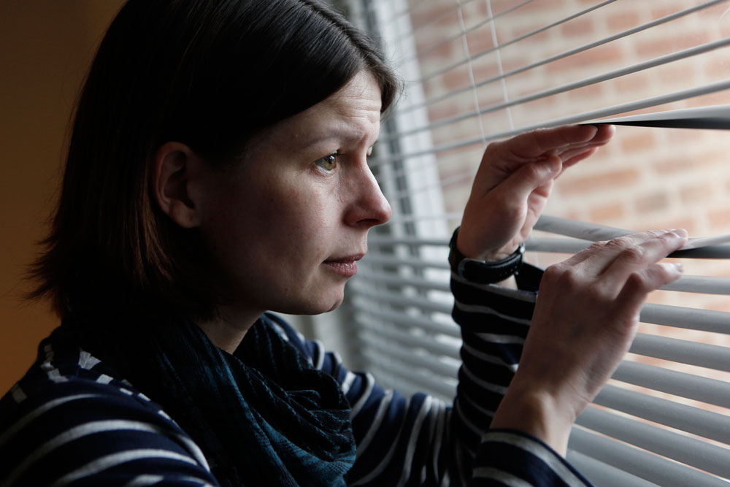
Stalking/Harassment
Making unwanted visits or sending you unwanted messages (over the phone, computer, etc)
Following you
Checking constantly
Public embarrassment
Refusing to leave when asked

Slide 26
Connecticut Member Organization Service Statistics
CCADV-through its member programs serves 50,000 victims per year
1,800 victims and their children stayed at our safe houses
14,000 individuals received counseling and support services
39,500 received court based services
22,000 crisis calls
12-16 fatalities annually
Last year to date, Prudence Crandall Center worked with over 410 clients in Southington
Notes:
CT Coalition Against Domestic Violence and member organization data.

Slide 27
Warning Signs of an Abusive Relationship
Seem afraid of anxious to please their partner
Go along with everything their partner says or does
Check in often with their partner to report where they are and what they’re doing
Receive frequent, harassing phone calls from their partner
Talk about their parent’s temper, jealousy, or possessiveness
Frequently miss school or social occasions without any explanation.
Difficulty making decisions. May show poor self- confidence
Be restricted from seeing family and friends
Rarely go out in public without their partner.

Slide 28
How to Respond to Domestic Violence?
Don’ts
Don’t tell the victim what they should do.
Don’t ask the victim what they did to deserve the abuse.
Don’t ask the victim what is wrong with them.
Don’t ask why they stay.
Do’s if the Victim is not Talking About The Abuse
Tell them you are concerned.
Ask the victim if everything is all right.
Give the victim an unmarked or marked card with a 24-hour crisis number.
Do’s if The Victim is Talking About The Abuse
Be a good listener. Just listen.
Ask the victim what they would like to do for themselves.
Ask the victim if there is anything you can do for them.
Give the victim an unmarked or marked card with a 24-hour crisis number.
Notes:
-Explain each one

Slide 29
Domestic Violence:
Impact on Children

Slide 30
Statistics
70% of children exposed to domestic violence are also victims of child maltreatment (Fantuzzo & Mohr, 1999)
15.5 million children live in households where domestic violence has occurred within the past year (McDonald et al., 2006)
Between 80% and 90% of these children are aware of the violence (McDonald et al., 2006)
Children raised in violent homes are 74% more likely to commit assault (Senate Hearing 1990; Sedgwick, 1992)

Slide 31
Definition of Children and Domestic Violence
Child exposure to domestic violence:
Seeing, hearing, being told about, seeing the aftermath of abuse used against a parent.
Child maltreatment/abuse:
Physical, sexual or emotional abuse or neglect
Several types of violence can be present in the same family!

Slide 32
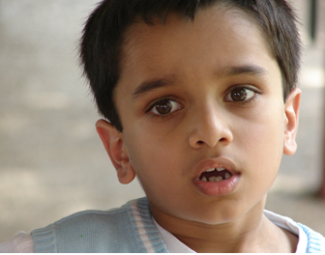
DV Impact on Children
Not all children are affected by domestic violence in the same way
Several factors may come into play for children who show great resiliency in the face of exposure to violence (Edelson, 1999)

Slide 33
How Childhood Trauma Affects Health Across a Lifetime
https://www.ted.com/talks/nadine_burke_harris_how_childhood_trauma_affects_health_across_a_lifetime
Notes:
How Childhood Trauma Affects Health Across a Lifetime- Nadine Burke Harris
https://www.ted.com/talks/nadine_burke_harris_how_childhood_trauma_affects_health_across_a_lifetime

Slide 34
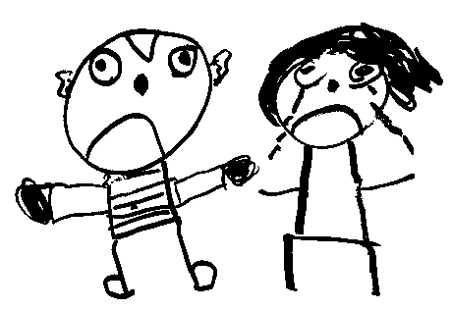
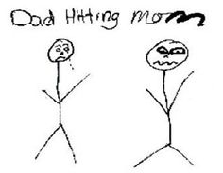
How Children are Exposed to DV
Hearing threats of physical harm
Feeling tension building in home prior to assault
Hearing/seeing assault on their mother/father
Being denied care because mother/father is injured or depressed
Being forced to watch or participate in violence against their mother/father

Slide 35
How Children are Exposed to DV
Seeing aftermath of violent incident
Having their relationship with their non-violent parent undermined
Being taken hostage to force victim to return home
Being enlisted by violent parent to align against non-violent parent
Experiencing the loss of a parent due to murder/suicide

Slide 36
DV Impact on Children
Domestic violence threatens a young child’s need for predictability, consistency and attachment
Watching, hearing or later learning about a parent being abused (by a partner) threatens children’s sense of stability and security
Children living with domestic violence are at increased risk of experiencing physical injury or childhood abuse
Children living with domestic violence are also at risk for increased emotional and behavioral problems

Slide 37
DV Impact on Children
Report of the Attorney General’s National Task Force on Children Exposed to Violence.

Slide 38
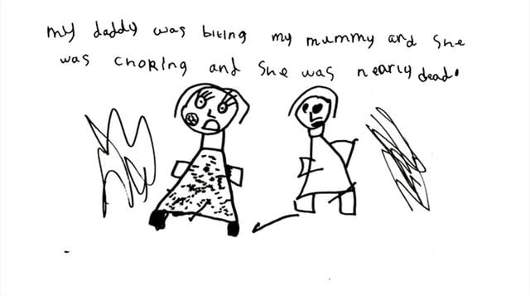
DV Impact on Children
Young children feel:
Fear
Confusion
Guilt
Anger
Frustration
Worry
Young children think:
I am responsible for the fight
Will I get in trouble?
Will I get yelled at or hurt?
Will I die?
Will mommy die?
Will I be rescued?

Slide 39
Teenagers
May intervene and get hurt
May feel embarrassed
May feel responsible for taking care of siblings and non-offending parent
May be angry at either or both parents
May be concerned about the well being of the non-offending parent
May develop risky behaviors- drugs, alcohol, etc.
May initiate sexual relationships early
May see a decline in school performance

Slide 40
What Children Learn
Violence and threats get you what you want
Violence is linked to expressions of intimacy and affection
A person has two choices: victim or aggressor
Victims are to blame for the violence
When people hurt others, they do not get into trouble
People who love you can also hurt you
Men are in charge, women don’t have the right to be treated with respect

Slide 41
Monsters in the Closet- Domestic Violence From a Child’s View
https://www.youtube.com/watch?v=LbRba9XHKKw
Notes:
Monsters in the Closet- Domestic Violence From a Child’s View
https://www.youtube.com/watch?v=LbRba9XHKKw

Slide 42
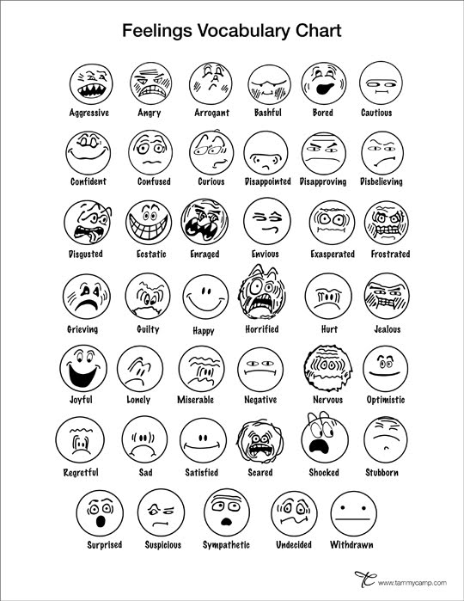
How to Help Children
Let children know the violence isn’t their fault
Help children identify their feelings
Listen to what children have to say
Create safe environments for children-establish routines
Recognize and applaud their strengths
Be a role model
TD411 teen dating app

Slide 43
Making Childhood Trauma Personal
https://www.youtube.com/watch?v=-HG8H4n2j9I
Notes:
Making Childhood Trauma Personal- Dr. Allison Jackson
https://www.youtube.com/watch?v=-HG8H4n2j9I

Slide 44
Contact Us
Prudence Crandall Center
P.O. Box 895
New Britain, CT 06050
www.prudencecrandall.org
Prudence Crandall Center 24-hour Domestic Violence Hotline
860-225-6357
Toll Free: 888-774-2900
Connecticut 24-hour Statewide Domestic Violence Hotline
888-774-2900 (English)
844-831-9200 (Español)
National 24-hour Domestic Violence Hotline
1-800-799-SAFE (7233)
Notes:
-Any Questions?

