Slide 1
Early Childhood Collaborative Series
Child Development
Presented by Steve Madancy
Assistant Superintendent
Southington Public Schools
October 25, 2017

Slide 2
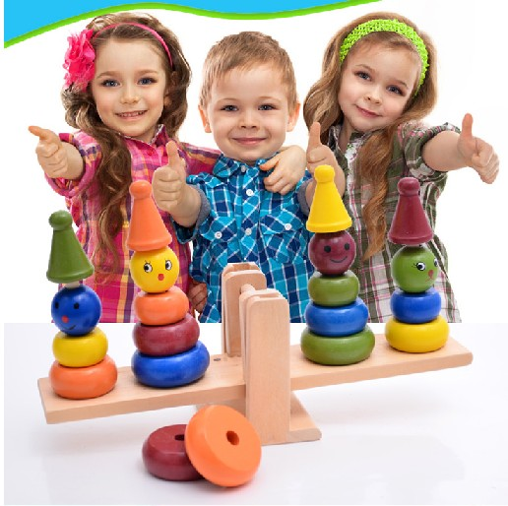
FINDING THE BALANCE?

Slide 3

DR. THOMAS ARMSTRONG
https://www.youtube.com/watch?v=aMx4Ui-F-tA

Slide 4

SHIFT TO FULL DAY KINDERGARTEN
Rationale
Crunch for time with competing interests
Academic Achievement Discourse
vs
Human Development Discourse

Slide 5
ACADEMIC ACHIEVEMENT DISCOURSE
Language Skills
Participate in conversations
Retell information from a story; read to him/her
Follow simple two-step, verbal directions
Speak using sentences of at least 5 words
Communicate feelings and needs
Listen attentively to a speaker

Slide 6
ACADEMIC ACHIEVEMENT DISCOURSE
Literacy Skills
Hold a book and turn pages from the front to the back
Explore books independently
Recognize printed letters, especially in their name and familiar printed words
Match/connect letters and sounds
Identify some initial sounds

Slide 7
ACADEMIC ACHIEVEMENT DISCOURSE
Numeracy Skills
Count to 10
Demonstrate one-to-one correspondence while counting (e.g. touches objects as he/she counts)
Measure objects using a variety of everyday items
Identify simple shapes such as circles, squares, rectangles, and triangles
Identify patterns
Sort and group objects by size, shape, function (use), or other attributes
Understand sequence of events (e.g. before, after, yesterday, today, or tomorrow)

Slide 8
HUMAN DEVELOPMENT DISCOURSE
Physical/Motor Skills
Run, jump, or balance
Kick or throw a ball, climb stairs, or dance
Write or draw using writing instruments (e.g. markers, chalk, pencils, etc.)
Perform tasks, such as completing puzzles, stringing beads, or cutting with scissors

Slide 9
HUMAN DEVELOPMENT DISCOURSE
Creative/Aesthetic Skills
Draw, paint, sculpt, or build to represent experiences
Participate in pretend play
Enjoy or participate in musical experiences (e.g. singing, clapping, drumming, or dancing)

Slide 10
HUMAN DEVELOPMENT DISCOURSE
Personal/Social Skills
Engage in self-selected activities
Interact with peers to play or work cooperatively
Use words to express own feelings or to identify conflicts
Seek peer or adult help to resolve a conflict
Follow classroom routines

Slide 11

BEWARE
Standards

Slide 12


WHAT TO FOCUS ON?

Slide 13

FINE MOTOR SKILLS
Introduction
Fine motor coordination skills are especially important for school aged children, since they spend much of their day manipulating small objects, and participating in handwriting, coloring, cutting, and gluing activities.

Slide 14
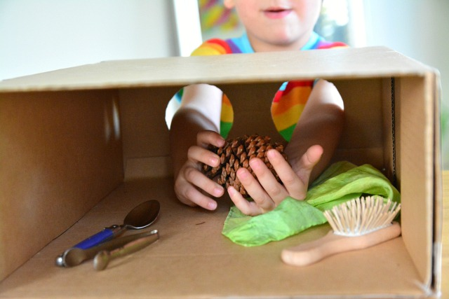
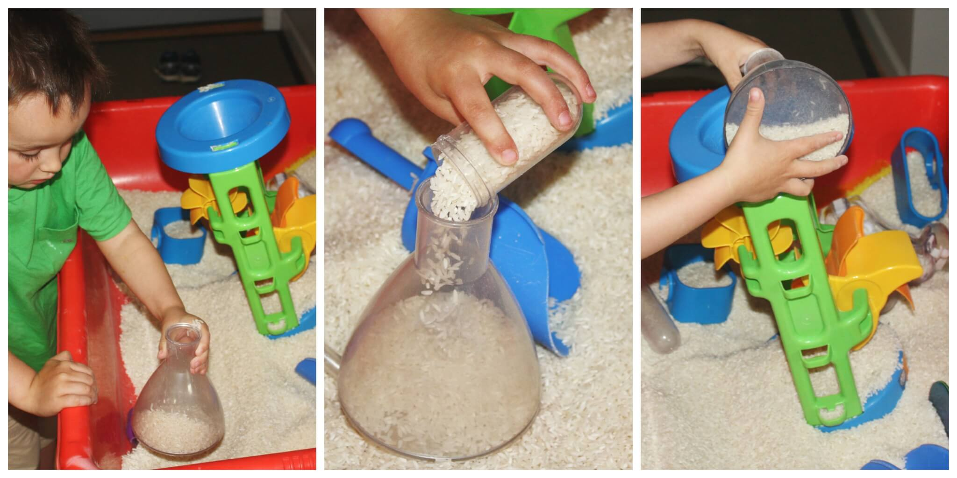
FINE MOTOR SKILLS
Examples of Activities
Collect a box of objects. With eyes closed, have the child pick up an object and see if s/he can guess what it is. Collect objects that feel different to each other (i.e. hard, soft, bumpy, prickly, rough, smooth).
Have the children “bury” their hands in a bucket filled with sand, rice, or very small beads for sensory input. *Practice writing letters, numerals, and words in the sand!

Slide 15
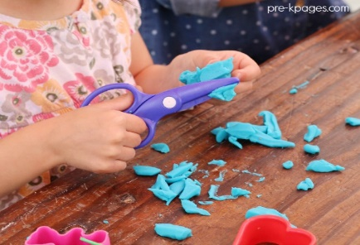
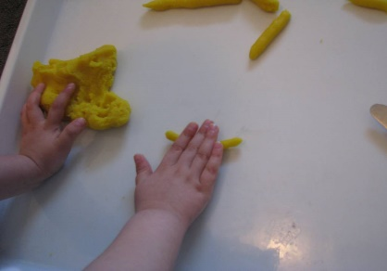
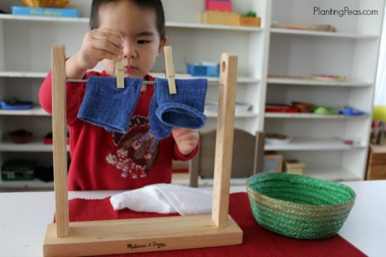
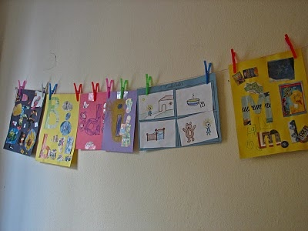

FINE MOTOR SKILLS
Examples of Activities
Playdough! Roll into small balls or use scissors to cut playdough.
Clothespins! Students can use clothespins to hang their artwork on the clotheslines in the classroom.
Squeeze Ball/Stress Balls!

Slide 16
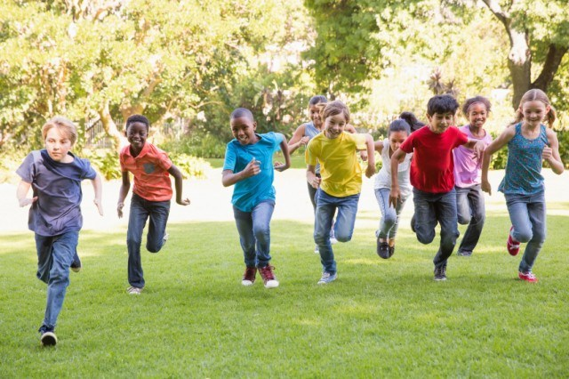
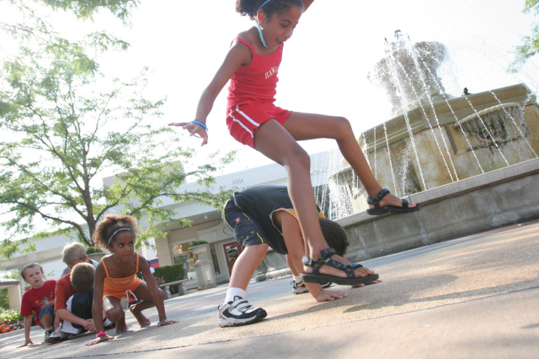
GROSS MOTOR SKILLS
Introduction
Gross motor skills are involved in movement and coordination of the arms, legs, and other large body parts and movements. Gross motor skills can be further divided into two subgroups of locomotor skills and non-locomotor skills.

Slide 17


GROSS MOTOR SKILLS
Examples of Activities
Locomotor movements
Walking
Running
Hopping
Jumping
Sliding
Skipping and galloping are tough!

Slide 18
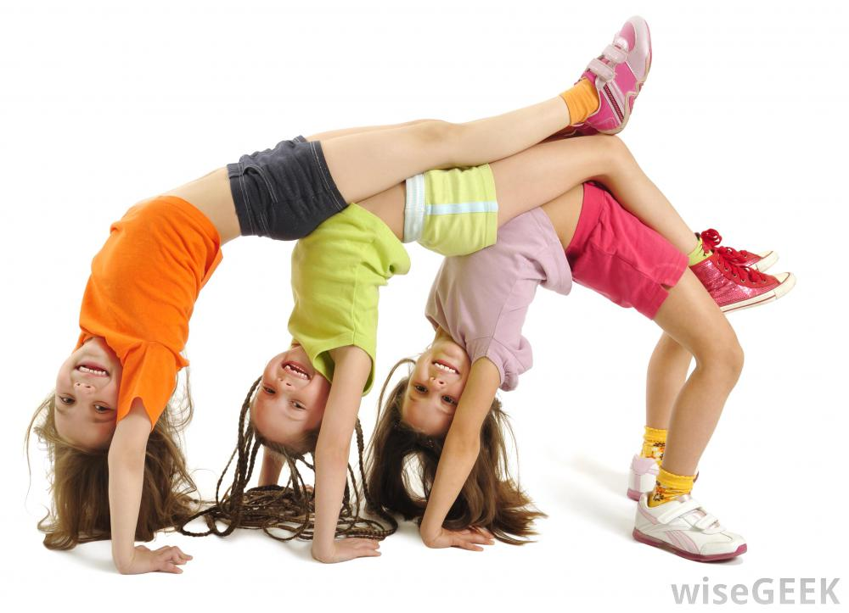
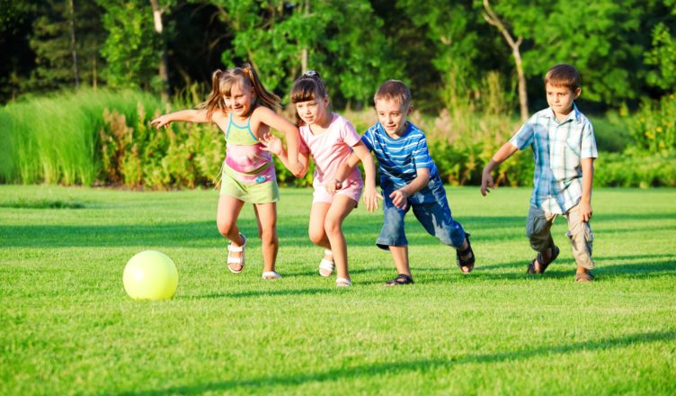
GROSS MOTOR SKILLS
Examples of Activities
Non-locomotor movements
Bending
Twisting
Turning
Kicking a stationary object
Throwing underhand
(not yet ready for overhand with proper form)

Slide 19

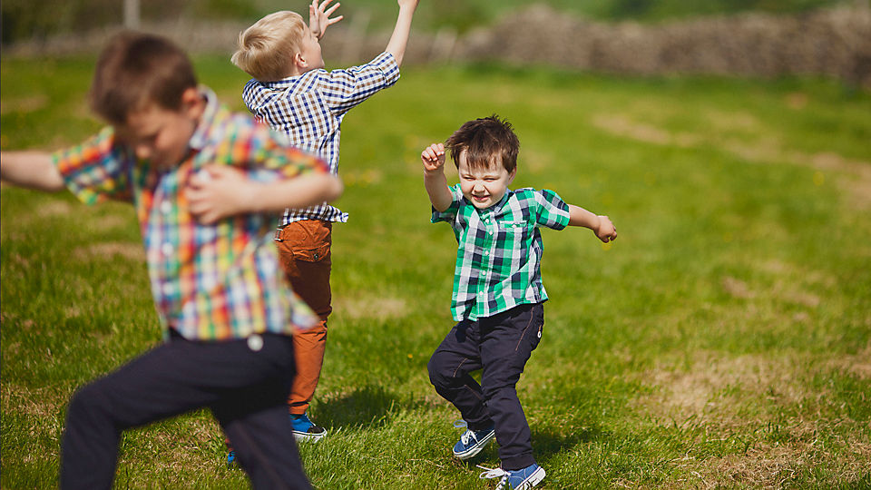
GROSS MOTOR SKILLS
Examples of Activities
Use music!
Music on…music off.
Move a certain way while music plays demonstrating body control and when music stops touch a body part to a paper plate or beanbag

Slide 20

PLAY…FUN…GROW
Keep it simple, let them play, have fun, and grow on their own terms!
Be honest with parents!

Slide 21

MOST DIFFICULT QUESTION
Is my child ready for kindergarten?

