Slide 1
Advocacy Workshop

Slide 2
Advocacy Workshop Agenda
Basics of Advocacy
Defining a problem, who can help, defining a solution, the process, key decision makers
State Legislature Overview
Committees, testimony, local legislators
2018 early childhood issues to watch

Slide 3
Why Advocate?
Solve a problem
Ensure your perspective is factored into the solution
Anyone can be an effective advocate
Case Studies in Advocacy
Creation of the Office of Early Childhood
Paid Family Leave
Obamacare repeal

Slide 4
What is the Problem
Describe the problem
How severe is it
Who does it effect
Why is it important

Slide 5
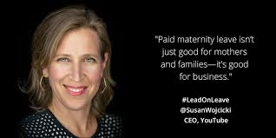
Who Can Help?
Others affected by the problem
People or organizations with expertise
Others who recognize the importance

Slide 6
What is the Desired Solution
Describe your proposed solution
What do you want done
By whom
Cost

Slide 7
Understand the Process
Which level of government can solve your problem?
Who within that level of government has the power to implement your solution?
What will the steps be to bring your solution to fruition?

Slide 8
Influencing Key Decision Makers
Build a relationship early
Establish your legitimacy
Introduction from a mutual friend
Provide useful information
Ask what the best way is to contact them
Sometimes it is through a key aide
Getting their cell number is important

Slide 9
Clearly State What You Want
If you can’t say what you want, how do you expect a decision maker to accomplish it?
Boil it down to a 30 second “elevator speech”

Slide 10
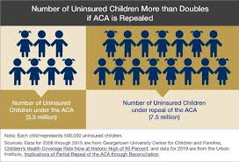
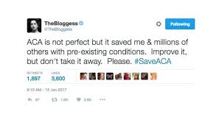
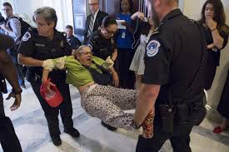
Build momentum
Reports
Petitions
Letters to the editor
Community meetings
Social media
Testimony at hearings
Letter writing to decision makers
Calls

Slide 11
Repeat
Don’t expect to win the first go round
Reflect on what worked and what didn’t
Refine your strategies
Find new allies
Be persistent

Slide 12
State Legislature
Committees
Timeline
Process as written and off-book
Local Legislators
cga.ct.gov

Slide 13
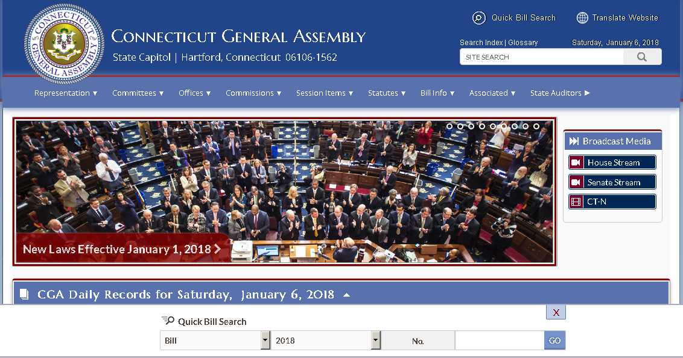

Slide 14
Early Childhood Issues to Watch
Budget & Revenue Proposals
Rescissions
Child health and well-being – HUSKY, behavioral health, obesity prevention, lead poisoning prevention
Child care – proposed regulations, Care4Kids, workforce compensation, blending funding
Family supports – paid family leave, two generation programs, predictive scheduling

