Slide 1

Presents
“The State of Early Childhood in Southington”
Tuesday May 15, 2018
Joanne Kelleher, Director
www.southingtonearlychildhood.org
© 2018 Early Childhood Collaborative of Southington

Slide 2
Agenda
Introductions
Community Foundation of Greater New Britain and First Years First
ECCS Overview
Birth Demographics
Childcare Options and Utilization
Kindergarten Readiness and SPS

Slide 3

David J. Obedzinski
President
david@cfgnb.org
cfgnb.org

Slide 4
Organized in 2003
Under fiduciary responsibility of the Community Foundation of Greater New Britain
Community Plan unveiled in May 2014 and maintained on ECCS website
5/15/2018

Slide 5
Goals of Early Childhood Collaborative
1) Advocating for high quality preschool and childcare
2) Empowering parents, families and childcare providers through workshops and educational programs
3) Being a wide-ranging resource for community members on the subject of early childhood care and education

Slide 6
Supporting the Community
Workshops for parents and providers
Encourage Pre-K and K registration
Books and math kits for incoming K students
Maintain list of resources on ECCS website
Share health, wellness and development topics
Publicize community events
Share other training opportunities with providers
Answer questions about childcare, providers, etc.
Update Community Plan

Slide 7
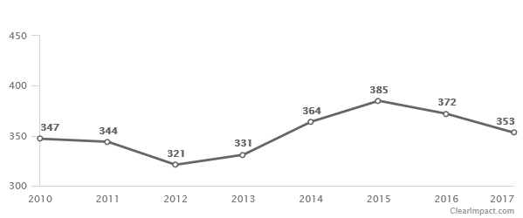
How Many Young Children Are There?
Babies Born to Southington Families
Age 0 to 4 years = 1,805
Per Connecticut Data Collaborative,
Age 0 to 4 years = 2,307 (±621)
5.28% (±0.74%) of total population
data.ctdata.org/visualization/population-by-age-by-town
Source: Town Clerk’s Office
Notes:
Is birth rate in Southington declining or increasing? 2012 is lowest year, those are in grade 1 now.
Age of data obtained locally is more current than from State.
For 2011-2015 (pulled in May 2017)
Age 0 to 4 years = 2,411 (±361)
5.53% (±0.83%) of total population
data.ctdata.org/visualization/population-by-age-by-town

Slide 8
Southington Births in 2015
Adequacy of Prenatal Care (APNCU Index)
  Non-Adequate 114 30% (down from 34.6% in 2014)
  Late or None 31 8.2% (down from 12.7% in 2014)
  Adequate 179 47.1%
  Intensive 92 25.5%
0 birth to a teen <18 and 2 to teens <20
Source - State of CT Public Health Data, 2015 Annual Registration Report, Tables 4 and 11 http://www.ct.gov/dph/cwp/view.asp
Notes:
Latest data available from this source.
From 2011 to 2015, a total of 25 teen births (age 15 to 19) in Southington, a rate of 3.9 per 1000 births. In CT the rate is 13.2 per 1000 births.
2014 Data
Adequacy of Prenatal Care (APNCU Index)
Non-Adequate 125 34.6% (up from 26.4% in 2013)
Late or None 46 12.7% (up from 7.6% in 2013)
Adequate 144 39.9%
Intensive 92 25.5%
1 birth to a teen <18 and 7 to teens <20
Source - State of CT Public Health Data, 2014 Annual Registration Report, Tables 4 and 11 http://www.ct.gov/dph/cwp/view.asp?a=3132&q=394598
Total of 35 births to teens age 15 to 19 from 2010 to 2014. (Table 13)
The Adequacy of Prenatal Care Utilization (APNCU) Index attempts to characterize prenatal care (PNC) utilization on two independent and distinctive dimensions - namely adequacy of initiation of PNC and adequacy of received services (once PNC has begun). The index uses information readily available on U.S. birth certificates (month of initial PNC visit, number of visits, and gestational age). It is a major improvement over existing indices, and is consistent with the 1985 American College of Obstetricians and Gynecologist (ACOG) recommendations for PNC utilization. This index does not assess quality of the prenatal care that is delivered, only its utilization.
More details are at http://www.ipodr.org/Overview_APCUIndex.pdf

Slide 9
Southington Births in 2015
 | Total Births | Foreign Born Mothers | %
Southington | 382 | 63 | 16.5
White non-Hisp | 332 | 32 | 9.6
Black non-Hisp | 7 | 3 | na
Other non-Hisp | 19 | 16 | 84.2
Hispanic | 22 | 10 | 45.5
Unk Race/Ethn | 2 | 2 | na
Source - State of CT Public Health Data, 2015 Annual Registration Report, Table 4 http://www.ct.gov/dph/cwp/view.asp
Notes:
Latest data available from this source.
86.9% of births = White non-Hisp
In 2014, there were 54 births to foreign born mothers or 14.9%
In 2013, there were 42 births to foreign born mothers or 12.7%
In 2012, there were 50 births to foreign born mothers or 15.6%
Country of Origin for 2013 foreign born mothers
Albania – 3
Algeria – 1
Austria – 1
Belarus – 1
China – 2
Republic of China/Taiwan – 1
Columbia – 1
Canada – 1
Dominican Republic – 1
Germany – 1
Haiti – 1
India – 5
Jordan – 2
Lebanon – 1
Macedonia - 1
Mexico – 1
Peru – 2
Pakistan – 1
Poland – 5
Portugal/Azores – 1
Puerto Rico – 1
Paraguay – 1
Russia – 1
Senegal – 1
Sudan – 1
Turkey – 1
United Kingdom – 1
Vietnam - 1
Yugoslavia - 1

Slide 10
Birth to Three Program
Birth to Three supports families when they have concerns about their children’s development.
Fiscal Year (June to July) | # referred | # served
2016 | 83 | 88
2015 | 88* | 103
2014 | 87 | 103
2013 | 76 | 93
2012 | 89 | 90
2011 | 66 | 94
Source: http://www.birth23.org/aboutb23/annualdata/
The 2015 FY referrals were reported in B23 Annual Report as 28, but B23 staff confirmed that was incorrect.
Notes:
Updated
An infant can be referred within days of being born and can continue to be eligible until their third birthday – almost three full years. Since this data is only a one-year snapshot, many towns will have more children served than were referred in FY16 because children were referred during a previous fiscal year.

Slide 11
Average Monthly WIC Participation
WIC provides food supplements to pregnant and post-partum women and children under 5
Year | Women | Infants | Children | Total
2015 | 44 | 54 | 94 | 192
2014 | 47 | 53 | 102 | 201
2013 | 41 | 57 | 108 | 207
2012 | 52 | 56 | 113 | 220
2011 | 47 | 54 | 111 | 213
Source: CT Department of Public Health State WIC Program – Statewide WIC Information System (SWIS)
Notes:
The Special Supplemental Nutrition Program for Women, Infants and Children, better known as the WIC Program, provides supplemental foods, health care referrals, nutrition education, and breastfeeding promotion and support to low-income pregnant, breastfeeding, and non-breastfeeding postpartum women, and to infants and children up to age five who are found to be at nutritional risk.
WIC serves 45 percent of all infants born in the United States.
In Southington, served 24.4% of infants born in 2015.

Slide 12
Licensed Childcare Centers – Fall 2017
 | Age | # | Cap | Enr | Vac
Infant | 0-17 months | 8 | 148 | 39 | 9
Toddler | 18-35 months | 8 | 197 | 67 | 13
Preschool | 3-5 years | 12 | 536 | 328 | 51
School Age | 5-12 years | 11 | 627 | NR | NR
List of all Southington childcare providers and other resources at http://www.southingtonearlychildhood.org/resources
Source: http://www.211childcare.org/reports/annual-child-care-capacity-availability-enrollment-survey-2017/
Notes:
Born to town residents – 331 to 385 per year over last 4 years.

Slide 13
Family Childcare Providers – Fall 2017
 | Age | # | Cap | Enr | Vac
Infant | 0-23 months | 30 | 60 | 22 | 6
Preschool | 2-5 years | 30 | 119 | 42 | 18
School Age | 5-12 years | 27 | 19 | 11 | 22
Women-owned small businesses owned run out of their homes. Licensed, registered and inspected. Must meet training requirements.
Limited to 2 infants and up to 6 pre-school age, plus school age.
Source: http://www.211childcare.org/reports/annual-child-care-capacity-availability-enrollment-survey-2017/
Notes:
Total infant capacity = 148 (up to 17 months) +60 (up to 23 months)= 208 vs 372 born in 2016.

Slide 14
Nursery Schools
 | Period | # | Cap | Enr | Vac
Age 3-5 | Fall 2018 | 3
Age 3-5 | Fall 2017 | 4 | 196 | 169 | 12
Age 3-5 | Fall 2016 | 4 | 248 | 212 | 19
Registration starts in January/February for fall and fills quickly
  Plantsville Community Nursery School – closing June 2018
  Village Green Nursery School – adding new classroom Fall 2018
  Zion Lutheran Nursery School
  YMCA Nursery School
Excludes Pre-K programs at Southington Catholic, CCA and SPS
Source: CT 211 Childcare’s Child Care Capacity/Availability/Enrollment Report – Fall 2016 and Fall 2017

Slide 15
SPS Integrated Preschool Program
As of 10/1/2015
  79 total students
  43 with disabilities - Special Ed or related services
  Community peers register in January, provide own transportation and pay a fee comparable to other nursery schools
Now offered at Hatton and Strong Schools
  Source: http://edsight.ct.gov/Output/School/NonHighSchool/1312011_201516.pdf

Slide 16
Childcare Costs
Childcare costs = in-state UConn tuition
Costs driven by adult-child ratios
Nursery Schools
  Age 3-5: $146-310 per month, PT, 2-3 days/week
Centers
  Infants/Toddlers: $200-$265 per week FT
  Preschool: $150 -$245 per week FT
Notes:
Currently, UConn tuition is $10,524 annually for in-state students plus $2,842 in mandatory fees year = $13,366,
$250/week = $13,000 per year, $200/week = $10,400 per year
When you search in the CT 211 Child Care system for programs that offer financial assistance, the only two that come up in Southington are the Margaret Griffin Center, thanks to United Way funding charges on a sliding scale, and the Hatton Integrated Preschool. http://search.211childcare.org/listings

Slide 17
Care4Kids
A state childcare subsidy for low-moderate income families.
Cuts in eligibility in 2016 and 2017 due to major budget issues led to decline in enrollment.
  February 2018 – 75 Southington children
  March 2017 – 93 Southington children
  June 2016 – 121 Southington children
The program has re-opened and currently has no waiting list.
Encourage people to apply. Providers must:
  be licensed by the CT Office of Early Childhood (unless exempt from licensing); or
  be a close relative, like a grandparent; or
  take care of the child in the child’s home.
Source: http://www.ctcare4kids.com/
Notes:
9 home-based Care 4 Kids providers in Southington. 7 of them are providing care for relatives and 2 hold a family child care license (down from 3 last year). #Centers – 7

Slide 18
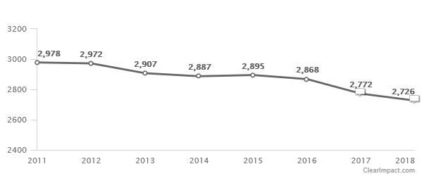
# of K-5 Public School Children
Source: Southington Board of Education, Registrar’s Office
Notes:
Time Period - Actual Value
1/18/2018 - 2,726
4/20/2017 - 2,772
2016 - 2,868
2015 - 2,895
2014 - 2,887
2013 - 2,907
2012 - 2,972
2011 - 2,978
2010 - 3,087
2009 - 3,088

Slide 19
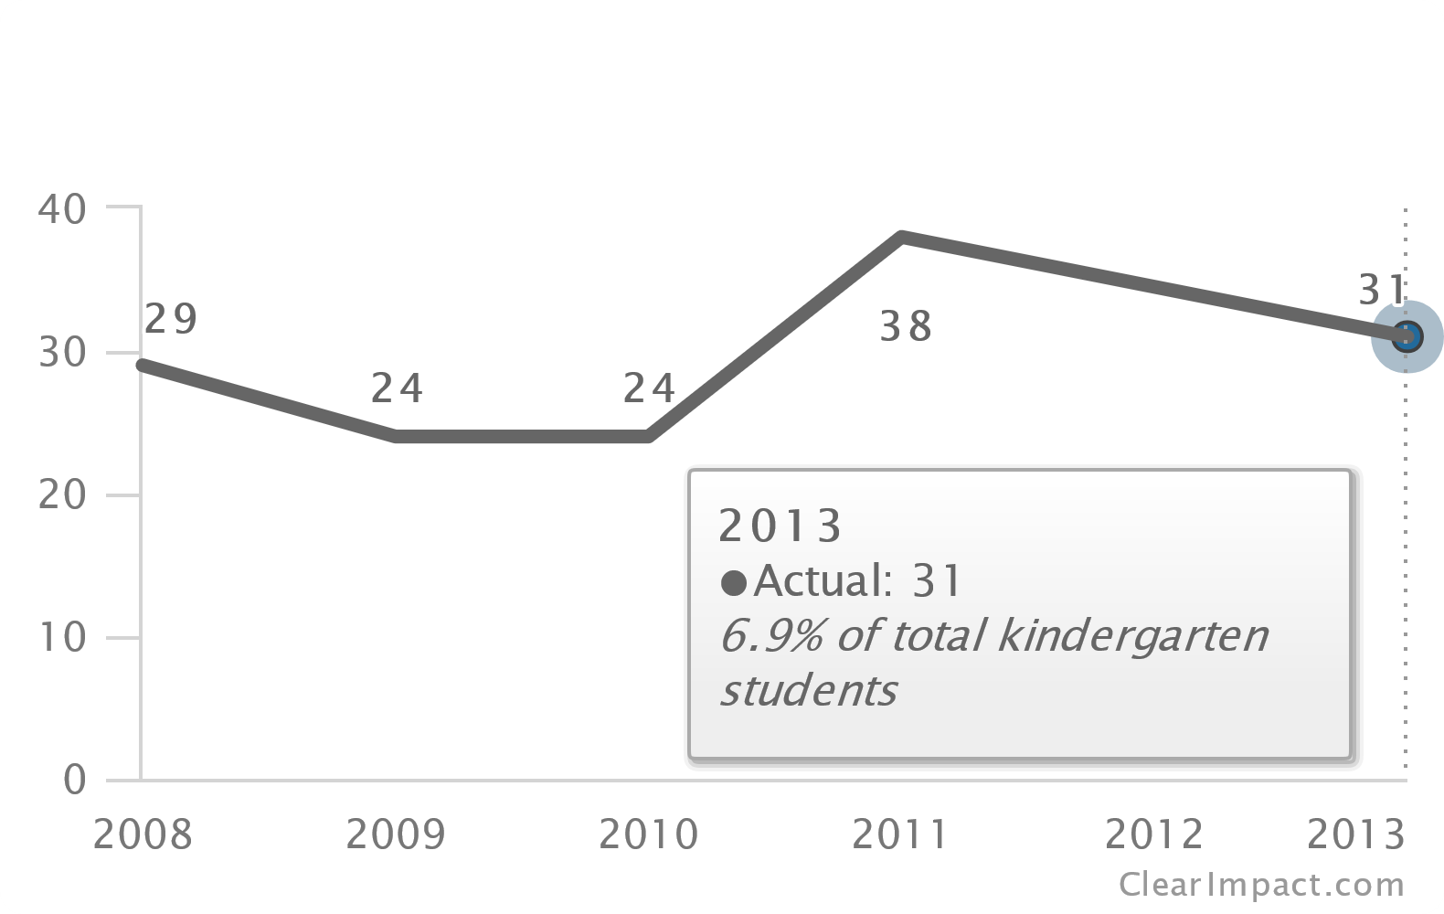
Kindergarten English Language Learners
Source: http://data.ctdata.org/visualization/english-language-learners
Connecticut State Department of Education
Notes:
Updated data not available
Data: (Source - Understanding the Needs of Our EL Students presentation by K Nichols/ L Clock/ D Assem
- 4/2017)
Parents of children in elementary school speak 21 languages –
Highest Percentage of Ethnic Groups/Languages Represented in Southington’s EL Population:
Polish 27%
Spanish 16%
Arabic 9%
Albanian 8%
Mandarin 7%
Southington EL Population Growth K-12
2004-05 - 49
2005-06 - 54
2006-07 - 88
2014-15 - 110
2015-16 - 105
2016-17 - 109

Slide 20
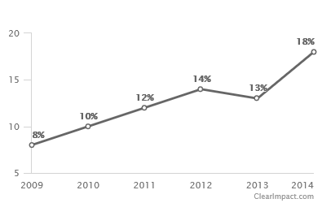
Eligible for Free and Reduced Lunch
Percent of Children Grades K-3
Free and Reduced Lunch eligibility:
- District on 10/1/2015 = 16%
- District on 10/1/2008 = 7.5%
- Flanders School in 2016-2017
= 26.64%.
Flanders’ percentage of free and reduced lunches SERVED in 2015-2016 of 44.53% made town eligible for State of CT School Readiness grants per Connecticut State Department of Education.
Source: http://data.ctdata.org/visualization/free-or-reduced-price-meal-eligibility
Notes:
New K-3 data not available.
On the 2016-2017 Consolidated Grant application, Flanders was listed as a Title I school with Free and Reduced Lunch eligibility at 26.64%.
Southington has four Title I schools which is based upon the percentage of free and reduced enrollment.
Eligibility indicates students from families whose total income is at or below 185 percent of the poverty level. Household income below 130 percent of the poverty level qualifies students for free meals. Household income between 130 and 185 percent of the poverty level qualifies students for reduced-price meals.

Slide 21
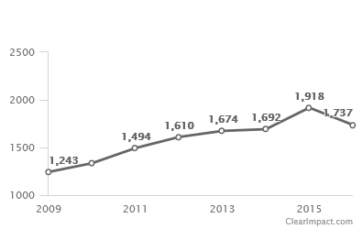
Children Under Age 19 Enrolled In Husky A
Data as of January of each year unless noted.
Source: http://www.ctvoices.org/node/2675
1804 in Husky A and 210 in Husky B as of July 31, 2016
Notes:
Updated data not available.
Data collected by CT Voices for Children from CT Dept. of Social Services. Funding for this project expired July 31, 2016.
262 Children under the age of 3 were in Husky A as of January 2016.

Slide 22
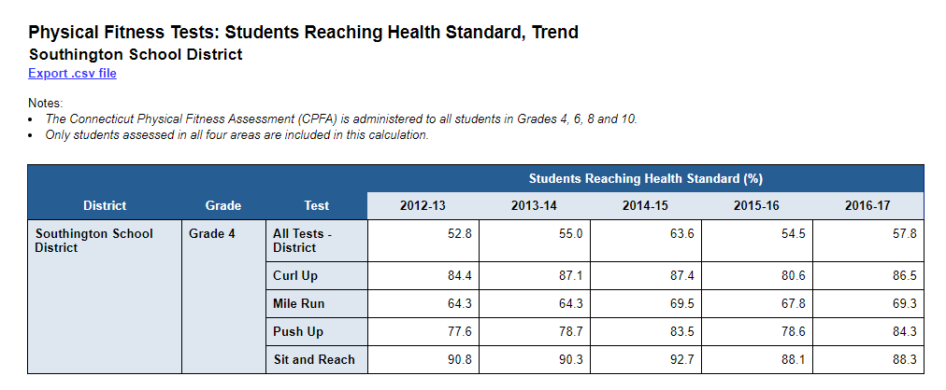
Health - CT Physical Fitness Test
Source: http://edsight.ct.gov/ Southington, Physical Fitness Tests Trend for Grade 4

Slide 23
Racial Makeup of District
2009 2013 2015
Source: ocrdata.ed.gov - Southington, LEA Summary of Selected Facts, 2009, 2013, 2015
Notes:
Civil Rights Data Collection - https://ocrdata.ed.gov/

Slide 24
Race/Ethnicity of Preschool Program -2015
Source: ocrdata.ed.gov - Southington, LEA Summary of Selected Facts, 2015

Slide 25
Retained in Kindergarten
Compared to overall enrollment, what is the race/ethnicity of students retained in Kindergarten?
Source: ocrdata.ed.gov - Southington, Retention 2015
Notes:
Of the 16, 4 were identified as LEP status and 2 were identified as disabled.

Slide 26
Educators by Race/Ethnicity 2016-2017
Source: Edsights - District Profile and Performance Report for School Year 2016-17
Southington School District

Slide 27
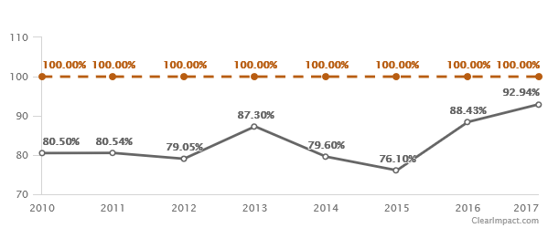
Children With Preschool Experience
Source: Connecticut State Department of Education and Southington Public Schools (2015-2017)
Notes:
Per the registrar’s office, for the 2017-2018 year, as of September 2017, 401 of the 422 registered for K attended a preschool, 98 outside of Southington/Plantsville. As of January 2018 - 408 of 439 registered attended a preschool and there are 417 K students enrolled. The difference between registered and enrolled is students who have moved out of town, selected another school or decided they weren't ready to start K this year.
For the 2016-2017 year, as of September 2017, 367 of the 415 registered for K attended a preschool, 99 outside of Southington/Plantsville

Slide 28
Upcoming Events
Touch-A-Truck – May 19, 2018
Car Seat Safety Check – June 6, 2018
Bicycle Safety Rodeo – July 2018
Gardening with Young Children Provider Workshop
Nutrition Workshops
Impact of Childhood Trauma Workshop
Behavior and Social-Emotional Provider Workshop
Kindergarten Readiness Series – October 2018

Slide 29
Support the ECCS
Tell a Young Family
Attend a Workshop
Make a Donation
Volunteer
Join Board
Attend Fundraiser
Follow, Like, Share Us on Social Media

Slide 30


Thanks to ECCS Funders
Community Foundation of Greater New Britain
Bradley Henry Barnes & Leila Upson Barnes Memorial Trust at the Main Street Community Foundation
Bristol Brass General Grant Fund and the Fuller & Myrtle Barnes Fund for Education at the Main Street Community Foundation
Women and Girls Fund at the Main Street Community Foundation
Petit Family Foundation
New - TBA on May 21, 2018

Slide 31
Thank You
Joanne C. Kelleher
Director
Early Childhood Collaborative of Southington
P.O. Box 210, Southington, CT 06489
www.southingtonearlychildhood.org
https://www.facebook.com/ECCSouthington/
https://twitter.com/ecc_southington
C: 860-877-4049

