Slide 1
GETTING READY FOR KINDERGARTEN: MOTOR READINESS - It’s More Than Writing Their Name
Presented by:
Susan Spatafore, Occupational Therapist
Diane Snow, Physical Therapist

Slide 2
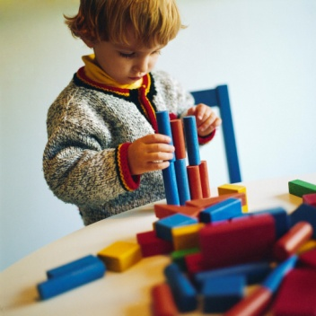
Early Development
Birth – early elementary school: Often referred to as the Sensory Motor phase of learning. Much of what children learn during this time is through their senses and moving through their environment. As they progress through the different phases of development, they strengthen their muscles, coordinate their movement patterns and learn to act on their environment. Many of today’s practices, although well-intentioned, have an impact on the development of a child’s motor skills.
*It’s not so important how quickly a child moves on to sitting, crawling or walking, but developing strength and skill at each stage…
Notes:
Positioning on back, excessive use of baby positioner, decreased movement activities, electronics (decrease physical exploring/manipulating, instant reward)

Slide 3
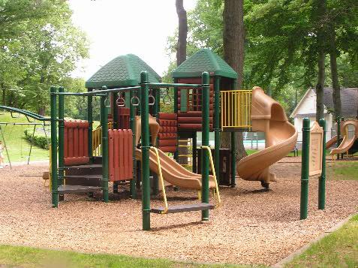
Preschool Motor Development:
Child develops and refines earlier skills
and strength needed for higher-level skills
Activities: all things movement!!!
Outside play
Running, jumping, climbing
Swimming
Animal walks
Playscapes
Ride-on toys (wear a helmet)
Balance games
Ball games: throw/catch, kick, t-ball, “golf”
Make an obstacle course
Help with gardening/yardwork
Help with chores: take out trash, carry/fold laundry, sweep, etc.
Imitation of movement, “Simon Says”
Using language when child is playing/moving helps to teach them concepts, such as body parts and directionality (top/bottom, over/under, around, up/down, left/right, etc.).
Positions!

Slide 4
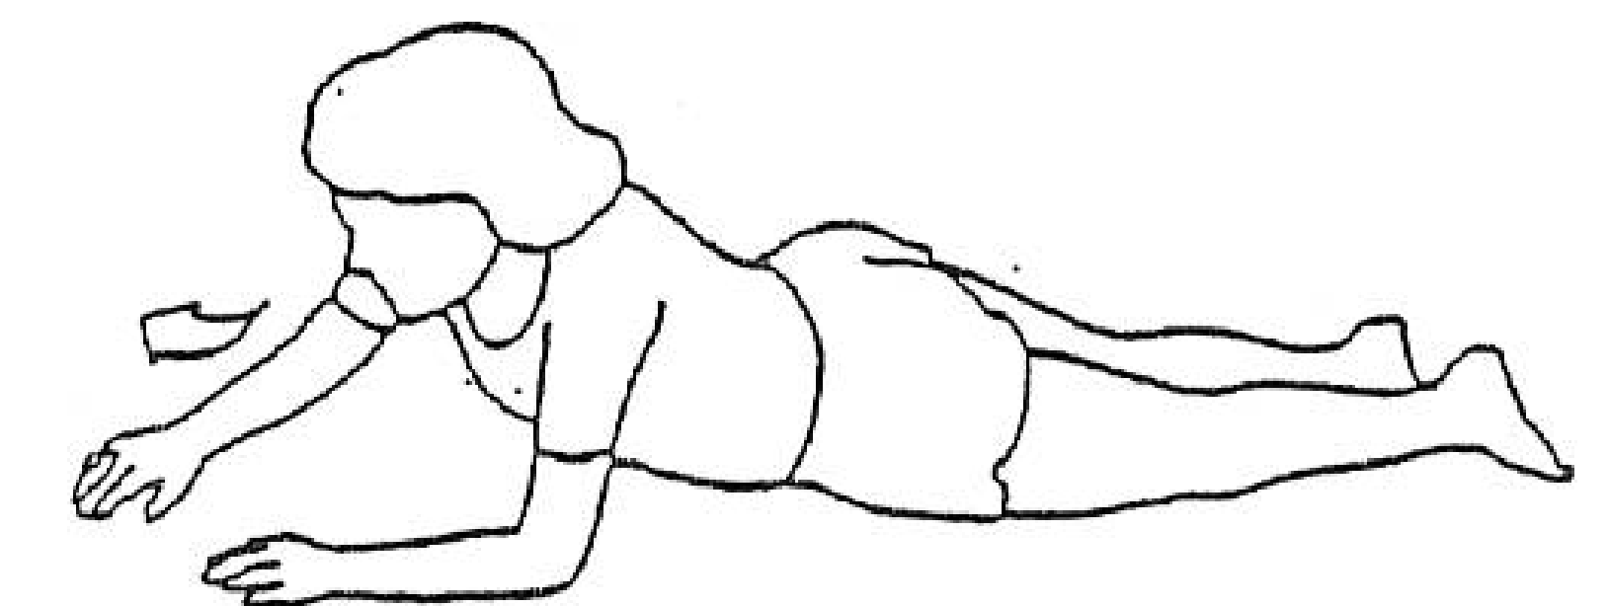
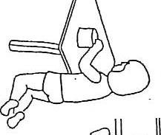
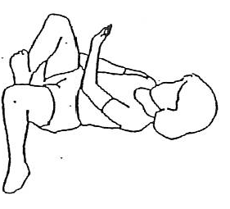
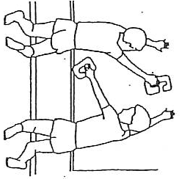
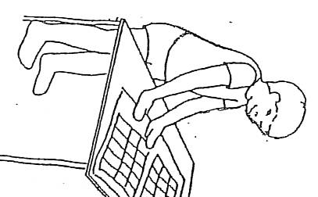
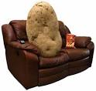
Positions : *Encouraging a variety of positions will help to build the trunk and arm strength needed to provide stability for body alignment during fine motor tasks. These positions will help to develop midline crossing and help to stabilize the body to develop isolated arm and finger movements needed in preparation for writing. They will also help to develop appropriate weight shifting needed for balance.
Even though the child spends much of their day upright and moving, floor play is still important! A few examples:
*Excessive “couch time” limits strength and motor development.

Slide 5
Screen Time:
Remember, children best learn spatial concepts and how things work together by actually moving within their world and manipulating objects (not by watching TV or using a mouse/touchscreen). Children learn through exploring with their whole bodies, including all of their senses.
Excessive screen time (TV, tablets, etc.) can limit:
Social skills
Language
Creativity
Attention
Fitness
*Some carefully monitored screen activities with quality content can benefit older children. But what’s most important for children is lots of time for hands-on creative and active play, time in nature, and face-to-face interactions.

Slide 6
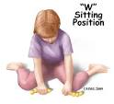
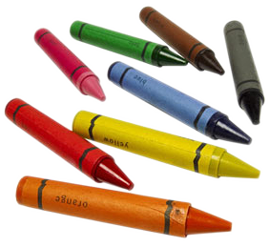
Looking at School Motor Readiness:
Ability to sit in a chair at kindergarten table
Maintain upright sitting position with hands free for coloring, writing, using scissors, etc.
Adequate endurance for length of table activity
Adequate balance/awareness of position to prevent falling out of chair
Ability to maintain upright sitting on the floor with peers for Circle
Strength to hold body up without leaning/using hands
Adequate endurance
Coordination of movement for fine motor skills
Readiness for pre-writing tasks
Finger isolation skills and readiness for tool use (scissors, markers, crayons)
Position should be discouraged

Slide 7
Looking at School Motor Readiness (continued):
Recess/Physical Education
Movement skills: run, jump, hop, gallop, skip, etc.
Ball skills: catch, throw, kick, etc.
Self-Help Skills – encourage independence
Dressing, including shoes, socks and coat
Bathroom routine
Assisting with fasteners
Putting away backpack
*Establishing routines at home prior to the start of the school
year will help your child become better organized

Slide 8
Pre-requisites for Handwriting Success
Skilled hand use
Wrist stability and forearm control
Balance/Postural stability and shoulder stability

Slide 9
Development of Grasp and Finger Skills:
18-24 months: Picks up crayon and scribbles, removes lid from bottle, snips with scissors, strings beads (2 or 3), turns one page at a time, improved use of spoon for feeding
36-48 months: Cuts with scissors, 3 shapes in form board, hand preference for dominant hand, can help with dressing (emerging for fasteners/buttons), assist to orient the clothes (front/back & right/left), emerging tripod grasp with movement coming from arm and wrist to color
5-6 years: Draws recognizable person (5 parts), connect dots, builds block pyramid, draws a person (6-9 parts), dresses independently (emerging for shoe tying)

Slide 10
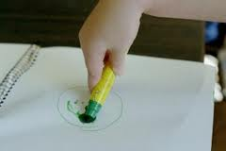
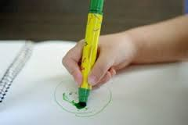
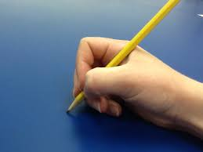
Pre-Writing Grasp Patterns: Typical developmental grasp/holding patterns for writing and coloring tools.
Tripod Grasp
3-4 years old
Skilled Tripod
Grasp
Gross Grasp Pattern
1-2 years old
Digital Pronate Grasp
2-3 years old
Fine Motor Skills involve how you hold things.
For example: reaching; grasping; manipulating objects; and leading to skilled use of crayons/pencils/markers and scissors, as well as the skilled manipulation of clothing fasteners.
If children are practicing their letters, encourage them to start at the top. Use a variety of method to teach them letters (sand, chalkboard, paper). Coloring is a great skill to support writing.

Slide 11
Handwriting
If children are practicing their letters, encourage them to start at the top. Use a variety of methods to teach them letters (sand, chalkboard, shaving cream, paper). Modeling for your child is helpful toward developing good writing habits. Tracing is helpful for learning the way their hands have to move.
Coloring is a great skill to support writing. Using broken crayons helps develop a better grasp (pincer grasp).
Coloring on a vertical (upright) surface is helpful for the development of efficient grasp patterns.
Play games where the child has to isolate the fingers from the rest of the hand (finger plays, legos, pick-up stix, games with tongs). This supports the development of the skilled side of the hand.

Slide 12
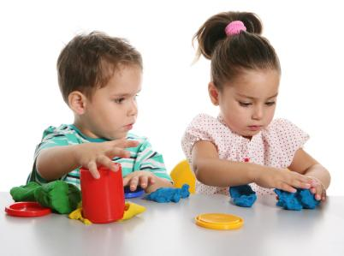
Fine Motor Development
Encourage participation in self-help skills
(manipulation of fasteners), finger foods (cheerios), participation in food prep
Facilitate strengthening through fun: putty/Play-doh™, cooking, sand table, chalk, painting/coloring on a vertical, counting with clothes pins/Legos™/blocks, puzzles, games (Operation™, Don’t Break the Ice™, cards), Finger plays (Itsy Bitsy Spider), pick-up sticks
Use of the hand involves building strength and coordination for skilled use (crayons, marker, scissors, pencil). Mechanics are important (thumbs up for scissor use and proper hold on marker/crayons).
Remember your power fingers (thumb, pointer, middle), 4th and 5th fingers are against the palm helping to stabilize the hand.

Slide 13
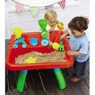
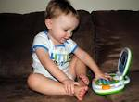
Toys –What are They Good For?
Pretending
Creating
Cognitive: Figuring Out How Things Work
Motor Skill Development
Emotional Expression
Social Interaction/Language
Play is “children’s work”
vs.

Slide 14
Anthony DiCarlo, the longtime principal of the William E. Cottle Elementary School in Tuckahoe, NY observed:
“Almost all our kids come into kindergarten able to recite their letters and their numbers,” Mr. DiCarlo said. “Some can even read. But in the last five years, I’ve seen a dramatic increase in the number of kids who don’t have the strength in their hands to wield a scissors or do arts and crafts projects, which in turn prepares them for writing.”
Many kindergartners in his community, he said, have taken music appreciation classes or participated in adult-led sports teams or yoga. And most have also logged serious time in front of a television or a computer screen. But very few have had unlimited opportunities to run, jump and skip, or make mud pies and break twigs. “I’m all for academic rigor,” he said, “but these days I tell parents that letting their child mold clay, play in the sand or build with Play-Doh builds important school-readiness skills, too.”

Slide 15
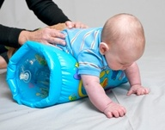
Resources
www.sensory –processing-disorder.com/fine-motor-development-chart
Pinterest (search Fine Motor Skills)
Pinterest.com/hollybeth214/physical-therapy/
themotorstory.com
hwtears.com
ctserc.org

