Slide 1
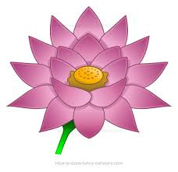
Living Mindfully
An Early Childhood Collaborative of Southington Workshop
Presented by:
Amy Inzero
ainzero@npsct.org
3/2/19

Slide 2
“Mindfulness is simply being aware of what is happening right now without wishing it were different; enjoying the pleasant without holding on when it changes (which it will); being with the unpleasant without fearing it will always be this way (which it won’t).”
– James Baraz

Slide 3
Today’s Goal:
To identify the benefits of mindfulness and apply mindfulness to my life and to my students
I will know I am successful when I can explain:
at least one benefit of living mindfully.
at least one way I can apply mindfulness to my life.
at least one way I can foster mindfulness with my students.

Slide 4
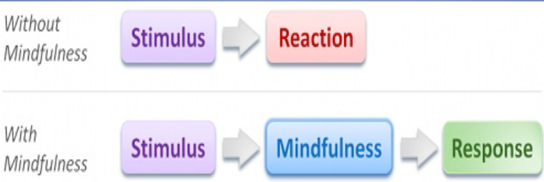
Research and Benefits:
“Mindfulness creates space, changing impulsive reactions to thoughtful responses.”
-Mindful Schools, Emeryville, CA
Yoga 4 Classrooms

Slide 5
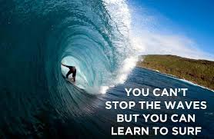
Benefits (for teachers):
Improves focus and awareness
Increases responsiveness to students’ needs
Promotes emotional balance
Supports stress management and stress reduction
Supports healthy relationships at work and home
Enhances classroom climate
Supports overall well being
Mindful Teaching and Teaching Mindfulness

Slide 6
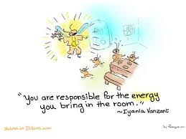
Benefits for Students
Supports “readiness to learn.”
Promotes academic performance.
Strengthens attention and concentration.
Reduces anxiety before testing.
Promotes self-reflection and self-calming.
Improves classroom participation by supporting impulse control.
Provides tools to reduce stress.
Enhances social and emotional learning.
Fosters pro-social behaviors and healthy relationships.
Supports holistic well-being.

Slide 7
Which Practices are Best for You?

Slide 8
Stillness and Staying in the Moment

Slide 9
The Importance of Breath
The practice is simply this: keep coming back to your breath during the day. Just take a moment. This will give your mind a steadiness and your breath a gracefulness.... There’s so much to let go of, isn’t there? Your nostalgia and your regrets. Your fantasies and your fears. What you think you want instead of what is happening right now. Breathe.
~Rodney Yee, Yoga: The Poetry of the Body

Slide 10
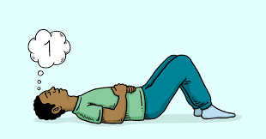
Mindful Breath Counting
Find a comfortable seated position
Close your eyes. Take a few deep breaths. Then let your breath come naturally.
Count 1 to yourself as you exhale.
The next time you exhale, count 2.
Continue this as you count to 5.
Then, begin a new cycle counting 1 on the exhalation.
Do not count higher than 5, and only count on the exhalation.

Slide 11
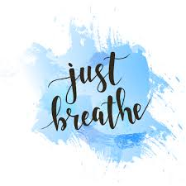
More Breathing...
3 Part Breath
Buddy Breath
Alternate Nostril Breathing
Bumblebee Breath
Breath of Joy
https://www.doyouyoga.com/the-7-best-yoga-breathing-exercises-both-on-and-off-your-mat/

Slide 12
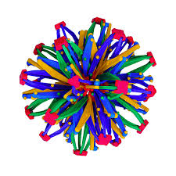
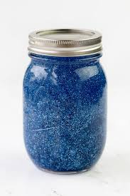
Visual Helpers...
Hoberman’s Sphere
Glitter Jar
https://heartmindkids.com/how-to-make-a-glitter-jar-for-mindfulness/

Slide 13
Consider This...
One good breath will allow a child to relax mentally and physically. One good breath will teach a child to pause before committing to her words and actions. One good breath will help a child release his anger and approach difficult situations with a clear mind. One good breath will help a child gather the courage to take a calculated risk , improve a child’s focus, so she can perform better at school , on the ball field, at home. One good breath will remind a child to smile, to forgive, to play, to love, to live. If one good breath will help a child to achieve all of this, imagine what a lifetime of good breaths will do.
Yoga 4 Classrooms

Slide 14
Resources related to mindfulness/stillness
Child's Mind: Mindfulness Practices to Help Our Children Be More Focused, Calm, and Relaxed by Christopher Willard: Advice and instructions for a wide range of mindfulness exercises, along with creative approaches to making everyday experiences more mindful.
Planting Seeds: Practicing Mindfulness with Children by Thich Nhat Hanh and the Plum Village Community: Instructions for dozens of mindfulness activities and noncompetitive games, which would be appropriate for classroom use or at home, summer camp, Sunday school, etc.
A Still Quiet Place by Amy Saltzman: An eight-week mindfulness curriculum, with a balance of sitting practice, mindful movement, and compassionate discussion, along with comprehensive guidelines on how to teach mindfulness.
Teach, Breathe, Learn: Mindfulness in and out of the Classroom by Meena Srinivasan: Mindfulness practices for busy teachers, as well as an eight-week mindfulness curriculum for students

Slide 15
Taking a Mental Break while Getting Physical Exercise

Slide 16
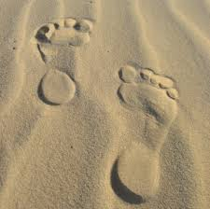
Mindful Walking
Stand and relax your abdominal muscles and take several deep belly breaths. Begin walking.
Walk so that one foot touches the ground on an inhale, and the other touches the ground on an exhale.
Notice thoughts as they come and let them float by.
Pay attention to the sensations of walking.
Count your steps in time with your breathing.
Counting Sounds & Rainbow Walking

Slide 17
Resources related to movement
Go Go Yoga for Kids: A Complete Guide to Yoga With Kids by Sara Weis: Advice for parents, classroom teachers, and professional yoga instructors on how to teach different ages of kids (3-6; 7-11; and tweens and teens) a variety of asanas (yoga poses), active movement, yoga games, and partner poses.
Little Flower Yoga for Kids by Jennifer Cohen Harper: "Gentle yoga practices to help kids pay better attention and balance their emotions, while building physical strength and flexibility."
https://yogibrarian.wordpress.com/2016/09/27/apples-yoga-storytime/
Yoga 4 Classrooms by Lisa Flynn
Teaching Yoga for Life by Nannette Tummers
Storytime Yoga by Sydney Solis

Slide 18
Compassion

Slide 19
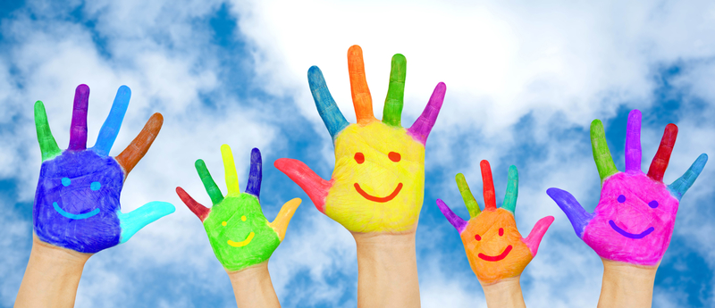
Listening Mindfully
What makes you feel happy?

Slide 20
Compassion Meditation
May you have happiness.
May you be free from suffering.
May you experience joy and ease.
May you have happiness.
May you be free from suffering.
May you experience joy and ease.
Self...Loved One...Neutral...Enemy...All Beings

Slide 21
Resources related to compassion
Happiness Doesn’t Come from Headstands by Tamara Levitt
The Mindful Child: How to Help Your Kid Manage Stress and Become Happier, Kinder, and More Compassionate by Susan Kaiser Greenland: Instructions and activities for the most effective ways to teach—and model—mindfulness to kids.
I Am Peace: A Book of Mindfulness by Susan Verde
littlefloweryoga.com

Slide 22
Additional Ways to Incorporate Mindfulness
Mindful Breathing, Observing, Listening, Walking, Eating
Quieting Rituals
Peace Corner
Calming Music for Transitions and Other Times
Honor Nature and Provide Outdoor Opportunities
Use Story Time Effectively
www.mindfulteachers.org

Slide 23
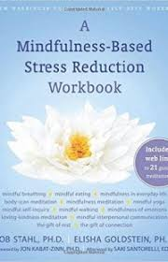
Resources
Books:
Building Emotional Intelligence by Linda Lantieri
Mindful Teaching and Teaching Mindfulness by Deborah Schoeberlein
Mindfulness for Teachers by Patricia A. Jennings
10% Happier by Dan Harris
Apps:
Insight Timer Headspace
Headspace Buddhify
Calm Mindshift

Slide 24
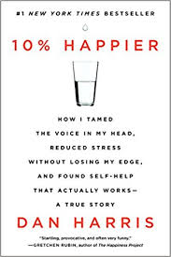
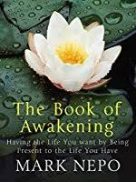
Resources
Websites:
www.jewelneverbroken.com
www.copperbeechinstitute.org
chopracentermeditation.com/
(Oprah and Deepak Meditation program)
www.crec.org/mindfulness/
(CREC Mindfulness Conference)

Slide 25
Wherever you go, there you are… Mindfulness practice means that we commit fully in each moment to be present; inviting ourselves to interface with this moment in full awareness, with the intention to embody as best we can an orientation of calmness, mindfulness, and equanimity right here and right now.
– Jon Kabat-Zinn.

